Slide 1

Zomato Restaurant Data Analysis Using SQL
Present By :- Sarthak Salvi

Slide 2

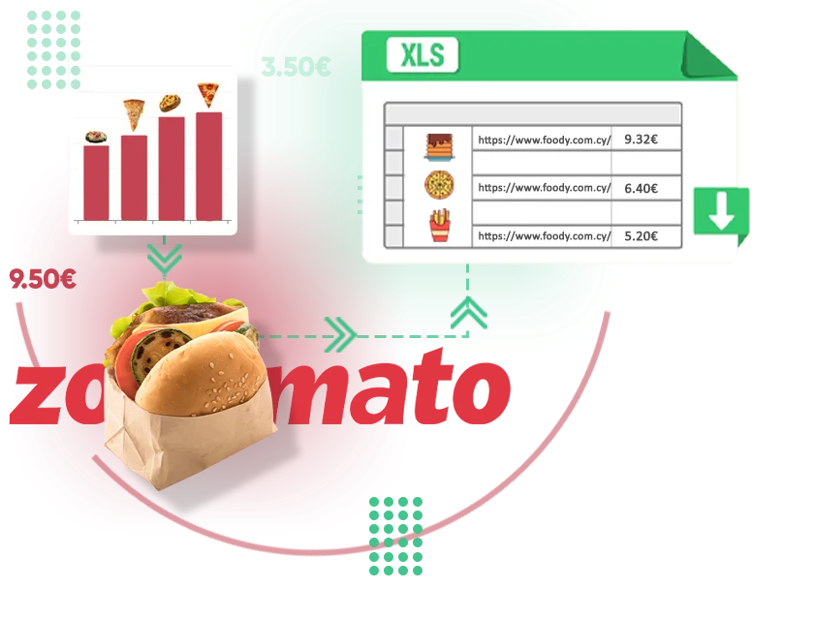
Objective
To explore and analyze Zomato’s restaurant dataset using SQL.
To derive meaningful insights through structured queries.
To implement DDL, DML and other operations for real-world data handling

Slide 3
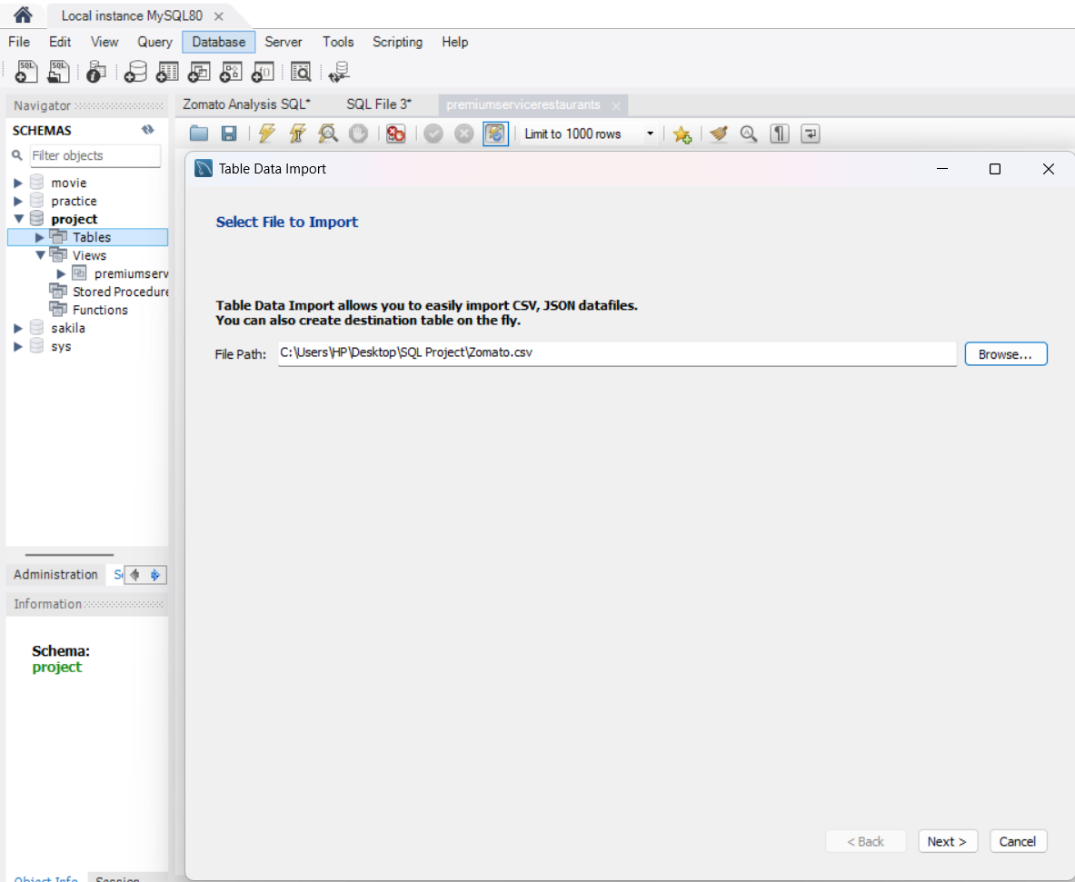
Importing Dataset in SQL DATABASE
Step 1 :- Create a database and import the dataset into the table.

Slide 4
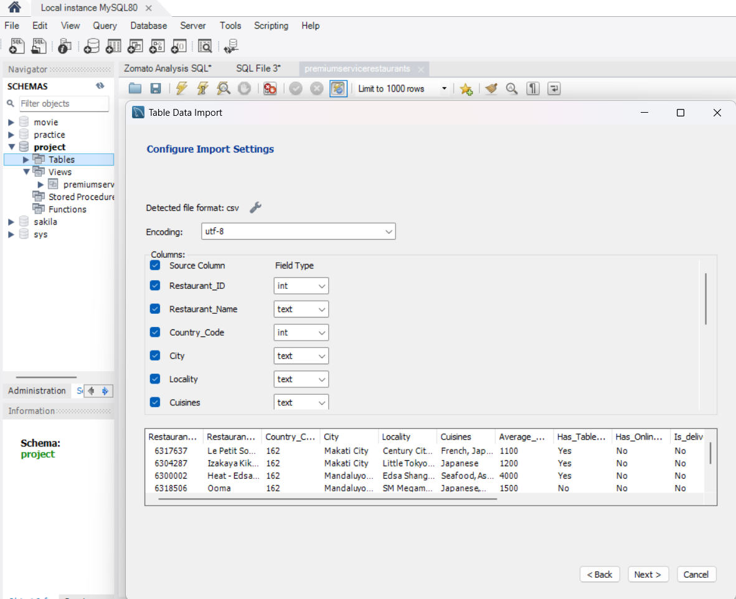
CONFIGURING IMPORT SETTINGS
Step 2 :- Configure import settings by checking the column names and its datatype before importing the data.

Slide 5
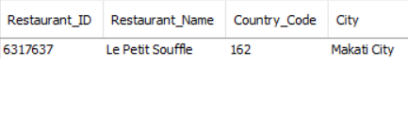

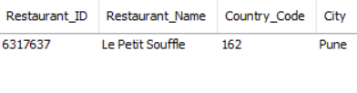
1. DML Command For Updating Data
Query :- (Used for updating the existing data in the table)
Output :-
Data before updating the record
Data after updating the record

Slide 6
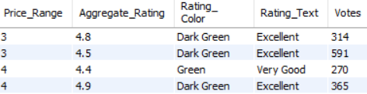

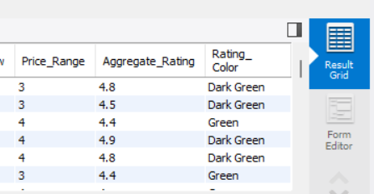
2. DML Command For DELETING Data
Query :- (Used for removing unnecessary data in the table)
Output :-
Data before deleting the record
Data after deleting the record

Slide 7
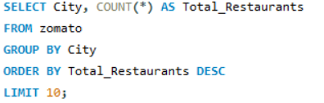
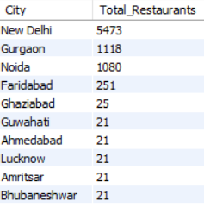
3. Top 10 Cities by Number of Restaurants
Query :-
Output :-

Slide 8
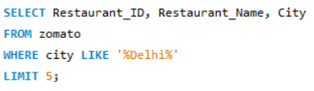
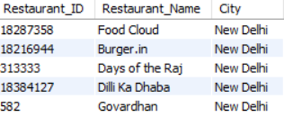
4. Find records where city contains "Delhi"
Query :-
Output :-

Slide 9
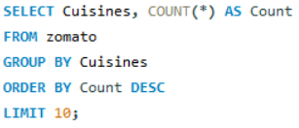
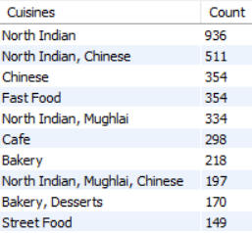
5. Most Common Cuisines
Query :-
Output :-

Slide 10
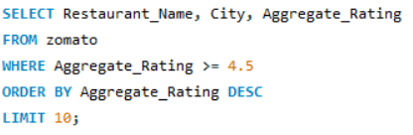
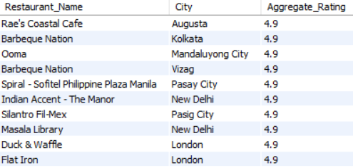
6. Restaurants with Highest Ratings
Query :-
Output :-

Slide 11
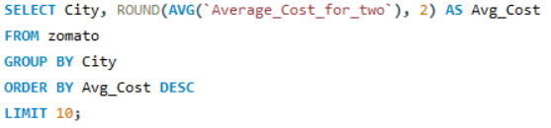
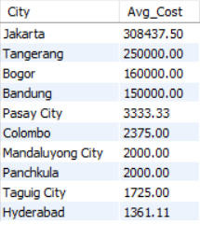
7. Average Cost for Two by City
Query :-
Output :-

Slide 12


8. Table Booking Availability Analysis
Query :-
Output :-

Slide 13
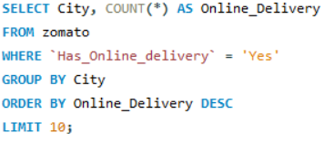
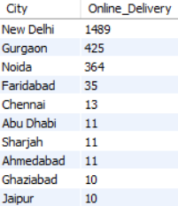
9. Online Delivery Availability by City
Query :-
Output :-

Slide 14
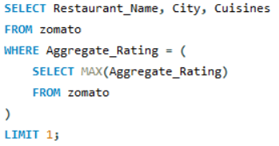
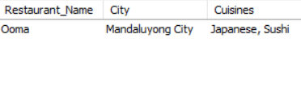
10. Cuisines Offered by the Highest Rated Restaurant
Query :-
Output :-

Slide 15
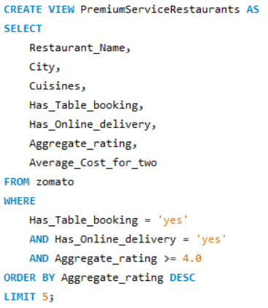
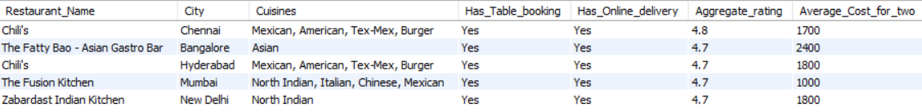
11. Which cities have restaurants that offer both table booking and online delivery, along with their average rating and cost?
Query :-
Output :-

Slide 16

Project Accomplishments
Updated and deleted data using DML.
Analyzed top cities by restaurant count.
Found most common cuisines and highest-rated restaurants.
Calculated average cost for two by city.
Analyzed table booking and online delivery availability.
Identified cuisines of top-rated restaurants.
Created SQL view to find restaurants with both table booking & online delivery, rating ≥ 4.0, and cost insights.

Slide 17


